Slide 1

Student Data Reporting Through I-station
Presented by: Jason Essig
E-mail: jason.essig@Harlandale.net
Phone: 989-4380
HISD I-station webpage: istationhisd.weebly.com

Slide 2
Test Procedures/ Reminders
Since this assessment will determine the level of rigor for each of your students, make sure they take it seriously and pace themselves.
Testing environments should quiet and without distraction; this is to ensure students have the best opportunity to be successful.
Classroom teachers should be present while students are assessing to ensure fidelity; this will ensure that the assessment reflects the student's true levels and abilities.
The assessment will take about 30 minutes for your students to complete, so please plan accordingly to allow students ample time to be assessed.
Allow them to use the pause button to take "brain breaks".
Have the students bring books, magazines, or print out an activity for them to work on while others are testing.

Slide 3
Running Reports and Explanation of Instructional Tiers
There are several reports that will be beneficial to run monthly to gauge student progress. They are:
ISIP Summary Report
Priority Report
Distribution Report
All of these reports contain the student’s individual instructional tiers.
Explicit directions on where to find these reports, how to run them , and an explanation of the instructional tiers can be found on the succeeding slides.

Slide 4
Explanation of Student Tiers
Instructional Tier Goals Charts:
The rigor of skill goals and expectations increase monthly by grade level.
Estimated ability level indices are used from each subtest to determine a student's overall estimated reading ability index.
ISIP Tier Goals help identify Overall Student Ability and potential growth.
The tabs at the top of the chart provide ability indices for individual subtests.
Charts differ by product: ISIP™ Early Reading, ISIP™ Advanced Reading, and ISIP™ Español.
Students are placed into instructional tiers based on ability indices.
Description of Instructional Tiers:
Tier 1: Students performing at grade level
Tier 2: Students performing moderately below grade level and in need of intervention
Tier 3: Students performing seriously below grade level and in need of intensive intervention

Slide 5
How to Obtain the Instructional Tier Goals Chart
To view the instructional tier goals for your grade level, click on the Toolbox tab at the top of the page.
You will then be brought to a drop-down menu where you can choose either ISIP early-reading or ISIP advanced reading.
Choose your appropriate level and you should get a chart like this.

Slide 6
Recommended Student Usage Based on Tiers
Supplemental Usage Criteria – Good Usage in the Supplemental category:
Tier 3 students use the program for 90 minutes or more per week.
Tier 2 students use the program for 60 minutes per week.
Tier 1 students use the program for 30 minutes per week.

Slide 7
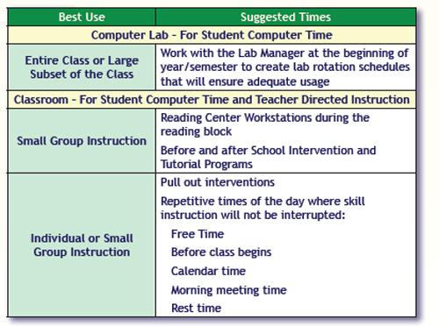
Instructional suggestions Chart

Slide 8
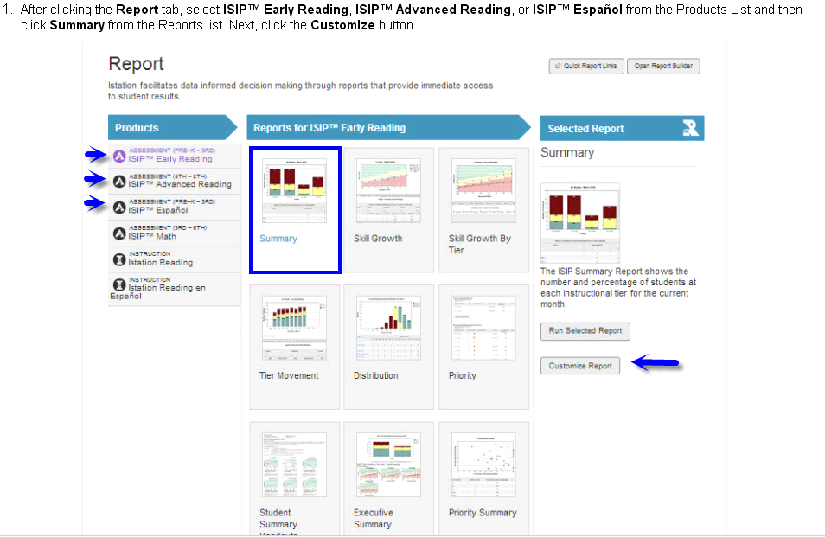

ISIP Summary Report
After your students have completed their initial assessment, run an student summary report.
From the home screen, click the report button to open the reporting screen.
On the side click on the proper grade-level/language assessment.
Then click on the summary report and hit the “generate report button”.

Slide 9
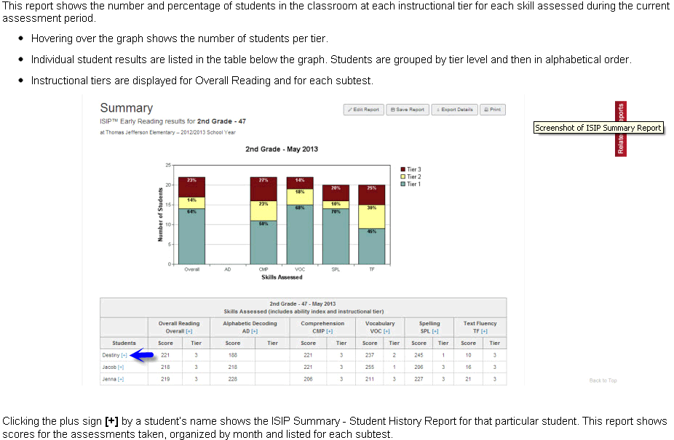
ISIP Summary Report
This report shows the number and percentile score of each student and which Tier they fall into to.
Hovering over the graph shows number of students in each tier.
Individual student results are listed in the table below the graph. Students are grouped by tier level and then in alphabetical order.
Clicking by a student’s name shows the ISIP Summary - Student History Report for that particular student. This report shows scores for the assessments taken, organized by month and listed for each subtest.

Slide 10
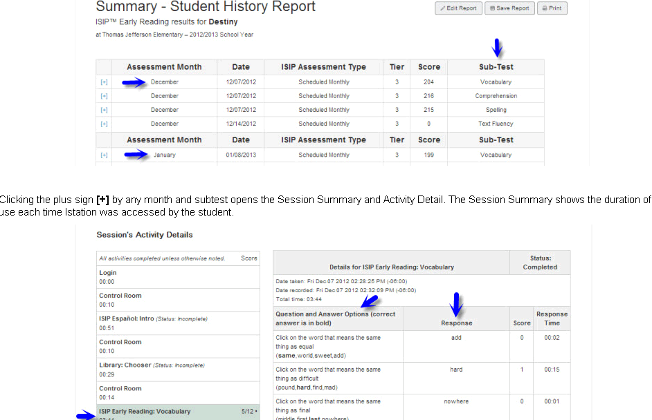

How to Read Your Student History Report
The assessment month column list the month of the assessment.
The score is the students score on the assessment.
The sub-test column will indicate which assessment was taken and scored.
In this view, clicking on the will allow to see the questions the students were given, how they answered each, and the time it took them to respond to each question.

Slide 11

Run a summary report and look at all the levels (classroom, teacher, student)
With a partner think-pair-share the following:
How would this report help you in your classroom instruction?
What information do you find useful in this report? Why?
What information can be taken from this report to help you develop small groups/ centers?

Slide 12
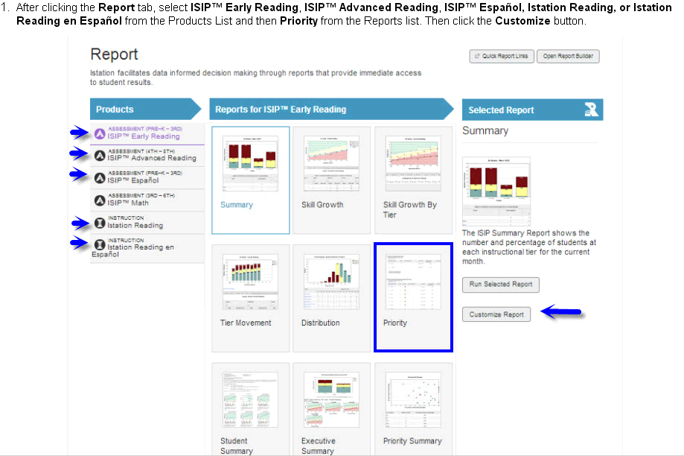
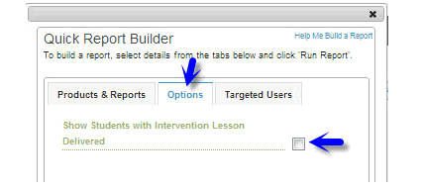
Priority Report
This report will be beneficial when determining what skills your students still need help with.
To generate this report, click on the reports tab and choose Priority.
Once clicked, the priority report t will bring you to the options screen.
When you select Show Students with Intervention Lesson Delivered, this will show ALL students who have DOCUMENTED INTERVENTIONS and students STILL IN NEED of intervention.

Slide 13
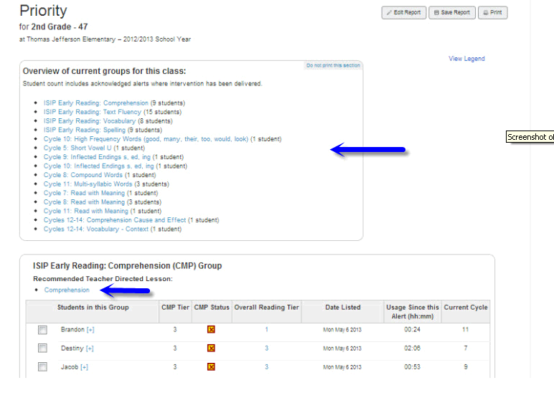
Priority Report (cont’d)
Students will only show up on the priority report if they are weak in a tested skill.
The report will give you a comprehensive overview of all the skills that were assessed.
When you click on the skill, you be taken to a screen that list the students that missed that particular skill.

Slide 14
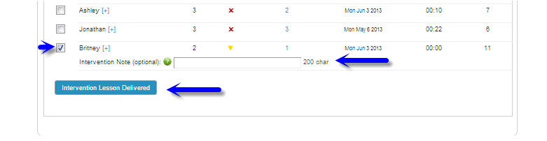
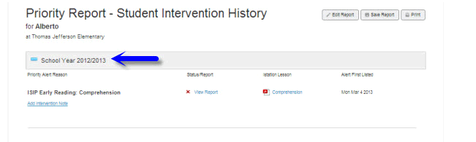
Priority Report (cont’d) and Intervention Lesson Retrieval
Once you have chosen the skill you want to re-teach, put a check next to a student’s name in the list.
Once a student’s name is checked, you will be able to title the intervention that you are using. *This can be used as documentation of intervention.
After checking the name, click the button Intervention Lesson Delivered.
The next screen will generate a printable lesson you can use for re-teach.

Slide 15
Tier 1 Intervention Lesson

Slide 16
Run a Priority Report for a classroom and look at some intervention lessons. With a partner discuss the following question using the say something strategy:
What intervention lessons would most beneficial for your class?
How will you use the intervention lessons to drive your classroom instruction?
What do you find useful about these lessons?
Based on this data, what intervention lessons will you be sharing full-group? Small group?

Slide 17
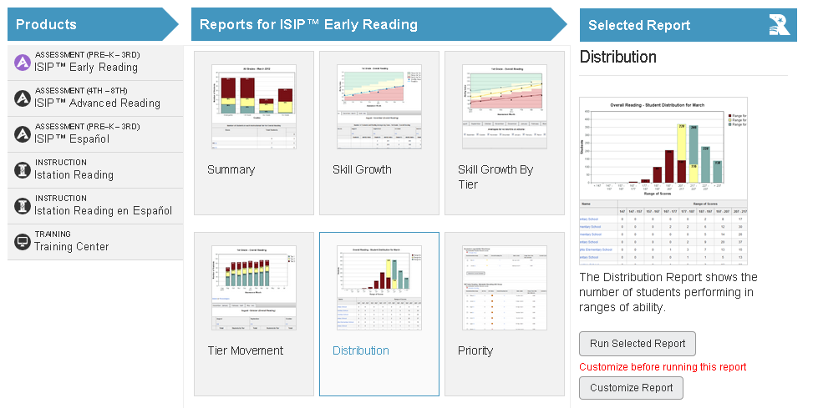
Distribution Report
This report allows you to see student performance by selected skill:
Overall reading
Listening comprehension
Letter knowledge
Phonemic Awareness
Alphabetic Decoding
Comprehension
Vocabulary
Spelling
Text Fluency
This report must be customized to run.

Slide 18
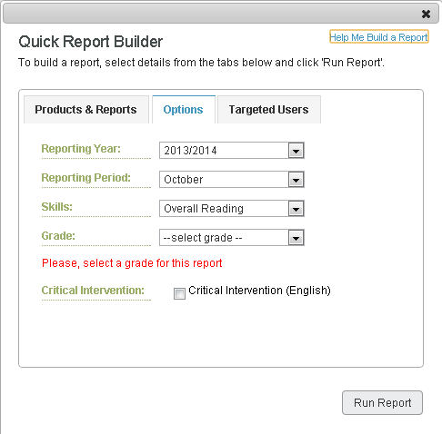
Customizing Reports
Start by selecting the year that you want reported.
Next choose, the reporting period (month) you would like to view.
Choose the skill.
Select the grade-level.
Click run report when done.

Slide 19
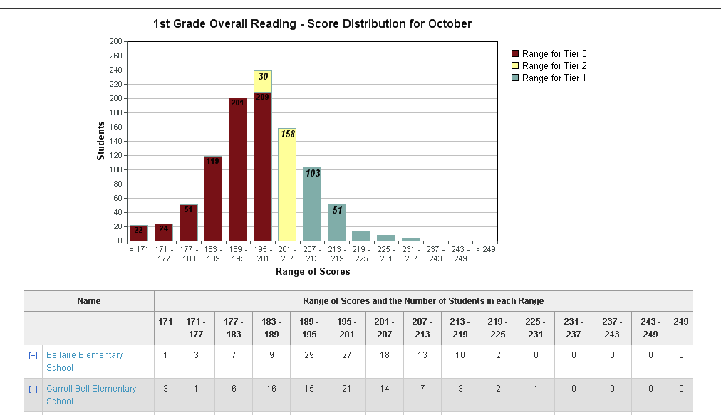
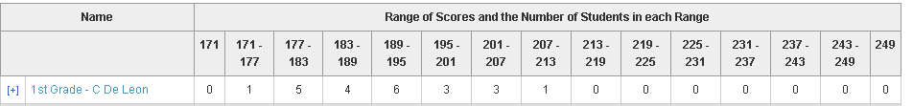
Distribution Report (cont’d)
The bar chart indicates number of students and the tier ranges they fall into.
Underneath is a list of the campuses.
Click the on the campus you would like to view.
Once clicked, you will see a list of teachers by their grade-level.
Clicking the next to your name to generate a report of all your students.

Slide 20
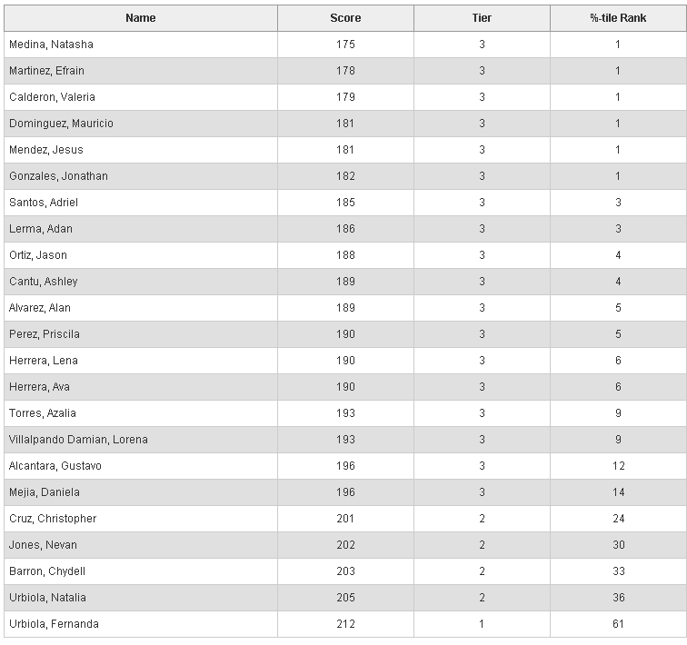
Distribution Report (cont’d)
This chart contains:
Student name
Their score on the skill you selected from their ISIP assessment.
The tier in which they fall in based on this score.
Their percentile rank

Slide 21
Run a Distribution Report for a classroom and look at some intervention lessons. With a partner discuss the following question using a think-pair-share:
What skills are your students struggling the most with? What strategies do you have in place to fix this?
What lessons or activities do you feel would most benefit your students?
Based on this data, what on-demand assessments or intervention lessons would you like to use?

Slide 22
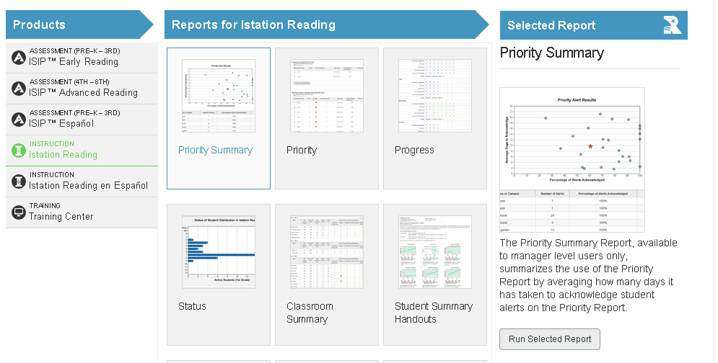
I-station Reading Reports
The priority summary allows you to view what intervention lessons were delivered, and the amount of time it has taken to view these lessons.
To run this report, click on I-station reading under products.
Under reports, click on Priority Summary.
Next, click on run selected report.

Slide 23
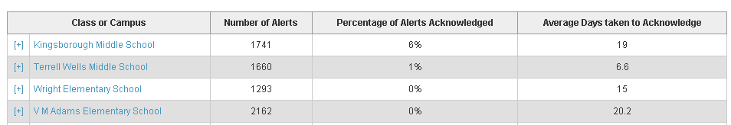
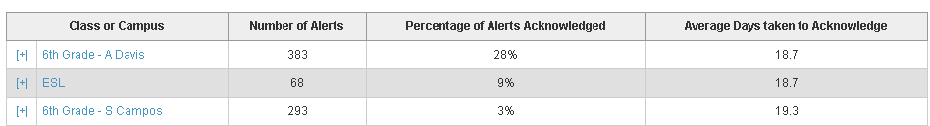
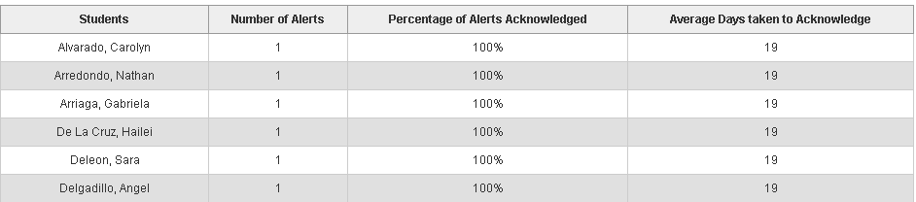
Priority Summary (cont’d)
First, you will see the name of the campus, the number of intervention reports, the % of alerts acknowledged, and the avg. number of days taken to acknowledge.
Click the next to your name to get a class list.

Slide 24
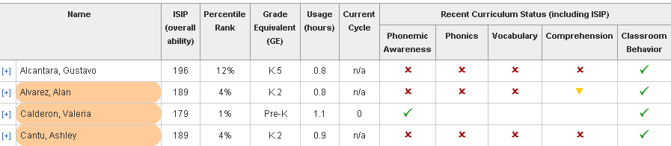
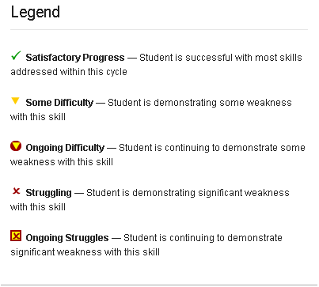
Classroom Summary Report (cont’d)
Initially this report displays:
Student’s ISIP overall score
Student’s class percentile rank
Student’s grade equivalency (K5, K2, 1.1)
Their current cycle in the program out of 15.
Their curriculum status based on the ISIP and interventions.

Slide 25
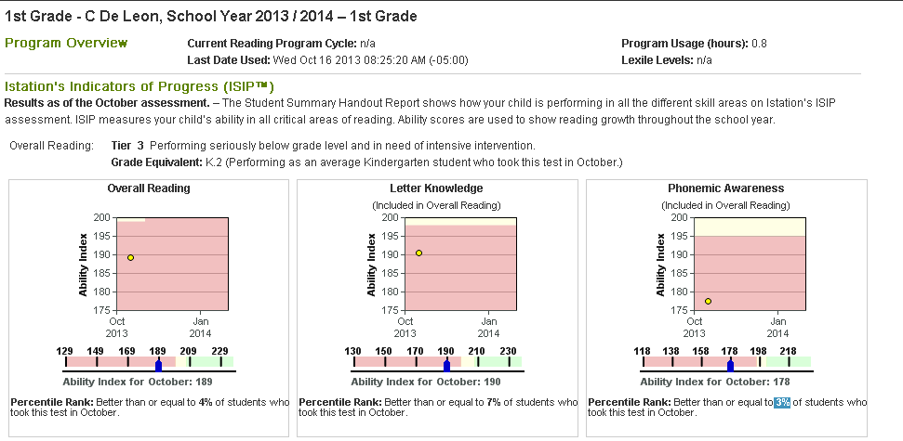
Student Summary Handouts (Classroom Summary Report)
Clicking next to a student’s name, brings up a student summary handout.
These handouts contains:
Program usage in hours
Lexile Level
Their tier and grade-equivalency.
For each tested area, there is a color-coded chart indicating where they are with that particular skill. (red is tier 3, yellow is tier 2, green is tier 1.)

Slide 26
Run an I-station reading priority report and discuss the following questions:
How will you use the classroom and student summaries to direct your instruction?
How might you use this report when conducting a parent/ teacher conference?
What information on this report can be used when setting up stations/ small groups?

Slide 27
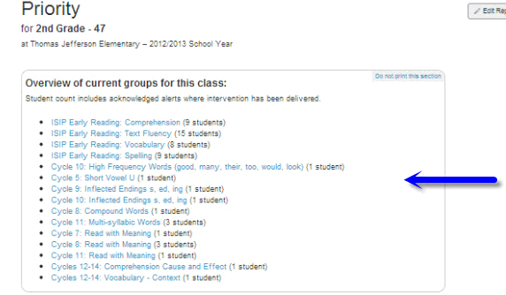
Using Priority Reports to Create Small Groups
Once you have run your priority report and determined what skills were missed most frequently, you can create small groups with the students listed under these skills to help mediate their instructional needs.

Slide 28
Small Group Creation
Purpose of Small Group Instruction:
Provide intervention or acceleration.
Focus on specific skills.
Teach strategy lessons.
Flexibly accommodate a variety of needs/purposes.
Steps for Small Groups:
Analyze student data to assess high need areas. (Priority Report)
Identify instructional focus for each group. (Priority Report)
Determine instructional activities, strategies, and resources. (Teacher Resources)
Implement and evaluate instruction. (ISIP™ Assessments)
Effective Use of Small Group Instruction:
Include skills previously taught.
Allow for peer collaboration.
Differentiate activities for varying skill levels.

Slide 29
Determining Group Numbers and Instructional Planning
After you have created your small groups to help mediate the similar instructional needs of your students, you can create a weekly intervention schedule for work stations or small groups.
Work Station and Small Group Planning:
Instructional Planning for Small Groups
Work Station Suggestions:
Work Station Suggestions

Slide 30

Teacher Station
The teacher station can be accessed, by logging into the student I-station icon.
This give you access to:
Online books: Spanish, English, some with audio
Writing: practices, strategies, and self-paced tutorials
Advanced Reading :literary elements, story elements, and more.
Science: life and physical science texts and instructional materials.
Early Reading: songs, stories, and interactive lessons.

Slide 31
Questions?

